Slide 1
Lab2: Data visualization and bulk RNA-seq analysis
CB2040
2022-09-26
Pontus Höjer
pontus.hojer@scilifelab.se

Slide 2
Two parts
Data visualization with ggplot2
RNA-seq analys

Slide 3
ggplot2
Adding color to something? The SciLifeLab brand colors are included in this templates’ “Theme colours”, found at the top row when opening the colour palette.
Grammar of graphics in R
Widely used with over 100 extensions

Slide 4
ggplot2
Adding color to something? The SciLifeLab brand colors are included in this templates’ “Theme colours”, found at the top row when opening the colour palette.
Structure:
Initialize a ggplot object with some input data (you can think of it as creating an empty canvas)
Specify what columns (variables) to include in the plot
Add a geom_* that defines the plot type (e.g. a bar chart or points)
Notes:
`aes()` (short for "aesthetic mappings") is used to tell `ggplot()` how variables in the data are mapped to visual properties of geoms.

Slide 5
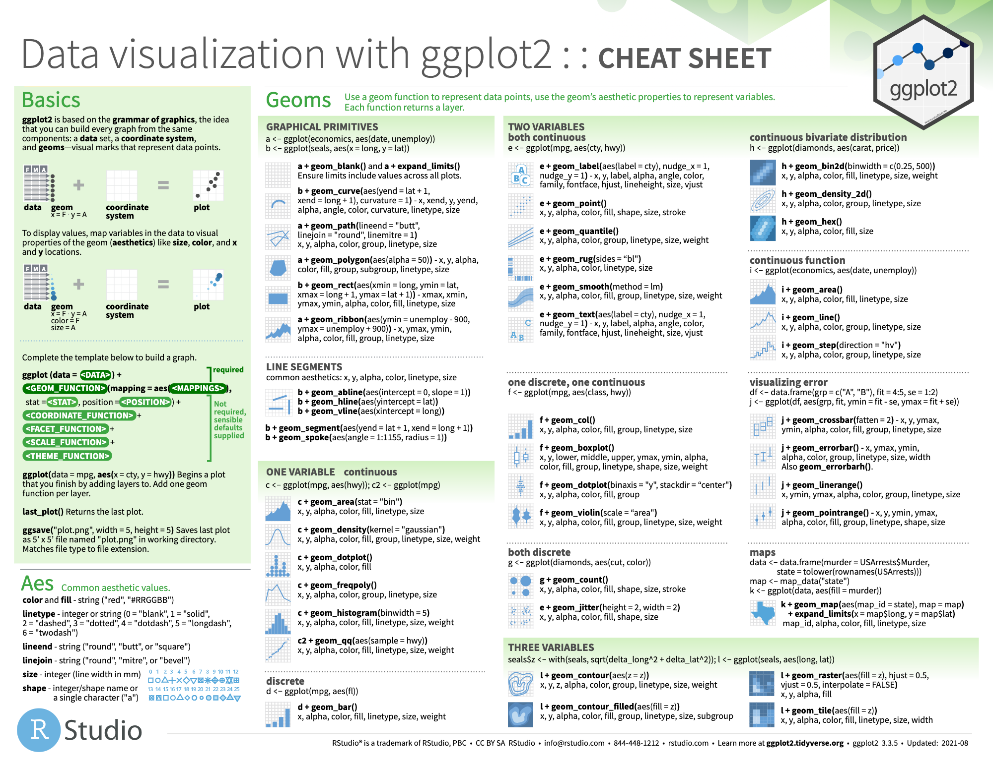
ggplot2
Adding color to something? The SciLifeLab brand colors are included in this templates’ “Theme colours”, found at the top row when opening the colour palette.

Slide 6
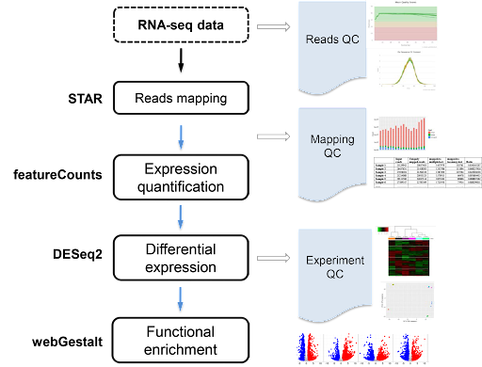
RNA-seq workflow
Lab workflow
Data workflow
https://rnaseq.uoregon.edu/
http://bioinfo.vanderbilt.edu/vangard/services-rnaseq.html

Slide 7
Data
Breast cancer samples from the Cancer Genome Atlas
5+1 subtypes
Her2, Basal-like, LumA, LumB, Normal-like and control
10 patients per subtype

Slide 8
DESeq2
Adding color to something? The SciLifeLab brand colors are included in this templates’ “Theme colours”, found at the top row when opening the colour palette.
Methods to test for differential expression (DE)

Slide 9
DESeq2
Adding color to something? The SciLifeLab brand colors are included in this templates’ “Theme colours”, found at the top row when opening the colour palette.
Methods to test for differential expression (DE)
Estimation of size factors, s_{j}
Estimation of dispersion, α_{i}
Negative Binomial GLM fitting and Wald statistics
Notes:
GLM = global linear model

Slide 10
Workflow
Preprocessing
DESeq2
Exploratory data analysis
Differential gene expression

Slide 11
Report
Return latest Monday 2022-10-03 23:59
Knitted .html file
Provide answer to all 9 questions
Good luck!

